Slide 1
THE history OF OUR SCHOOL

Slide 2
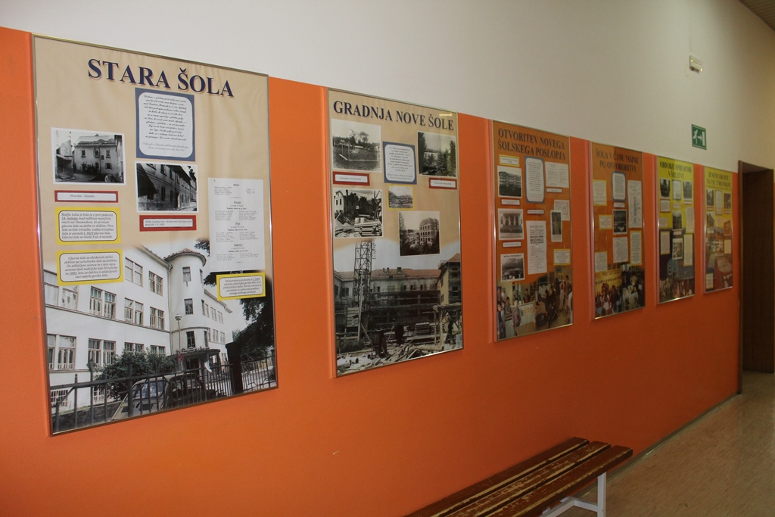
The billboards
On the lower levels of our school we made the billboards that show the history of our school.

Slide 3
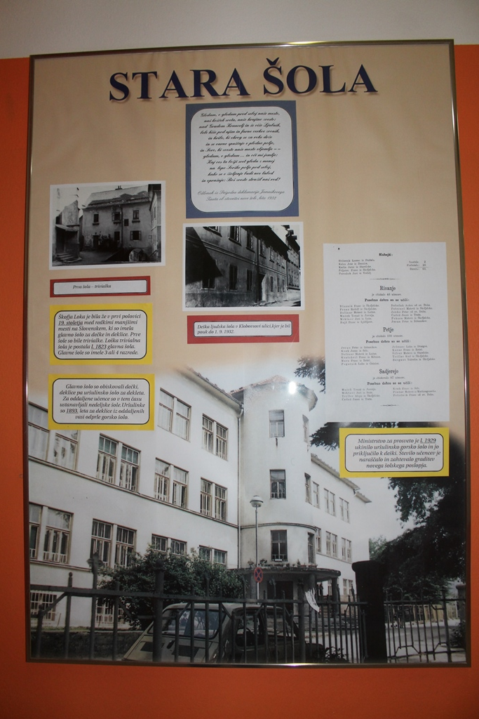
The first poster
The first poster shows the old school that
Stood before the current one. Škofja Loka
was one of the first small towns in
Slovenia that had a major school for
both boys and girls.

Slide 4
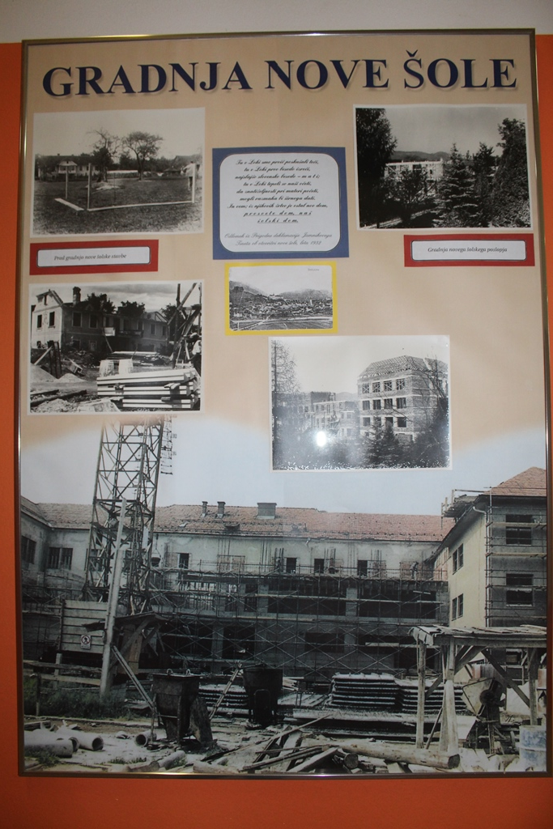
The new school
The next poster shows the construction
of the new school.

Slide 5
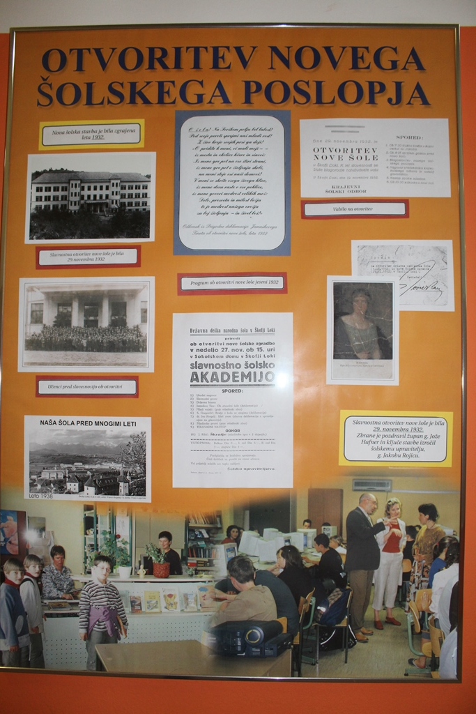
The unveiling
Next in line is the poster that shows
the unveiling of the new school. The
unveiling took place on the 29th of
November 1932. on that day we celebrate
our day of the school.

Slide 6
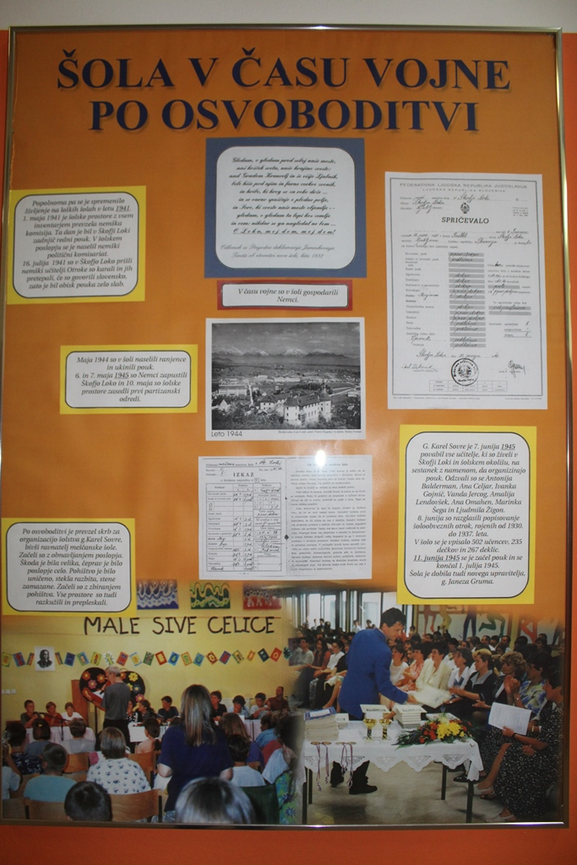
The war
In the time during the war the school
was controled by the Germans and used
as chambers for the wounded. In 1945
it was again used for teaching children.

Slide 7
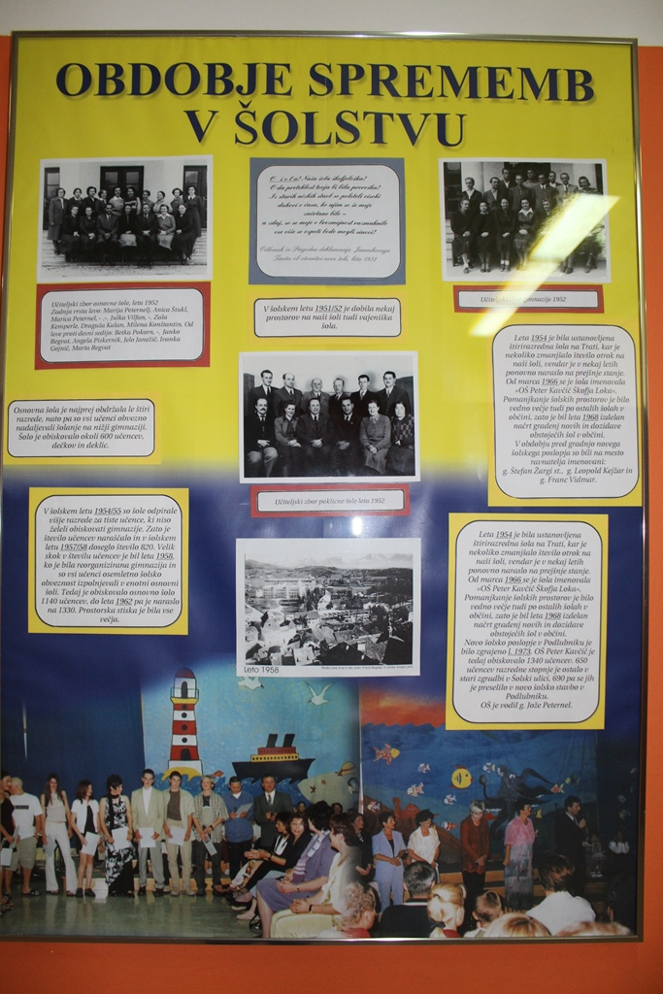
The changes
This poster shows the changes
made in the school sistem and our
school in particular.

Slide 8
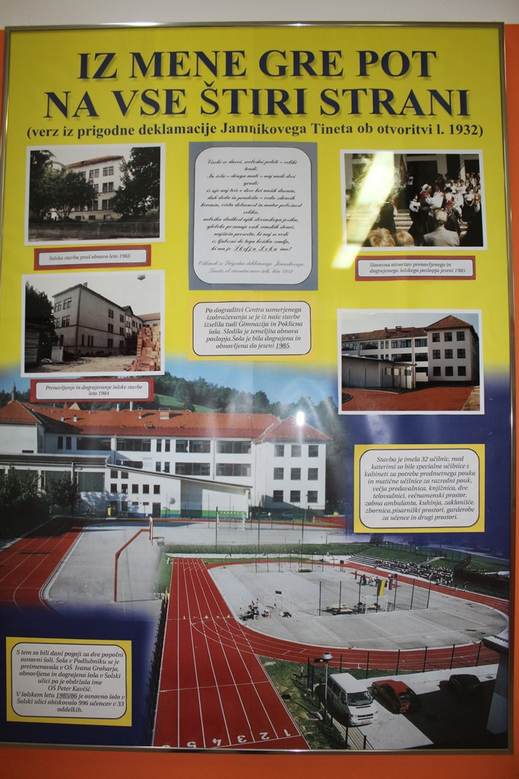
The new look
Here it is shown how many classrooms
there were in the school and how it looked.
It also shows the race track behind the
school.

Slide 9
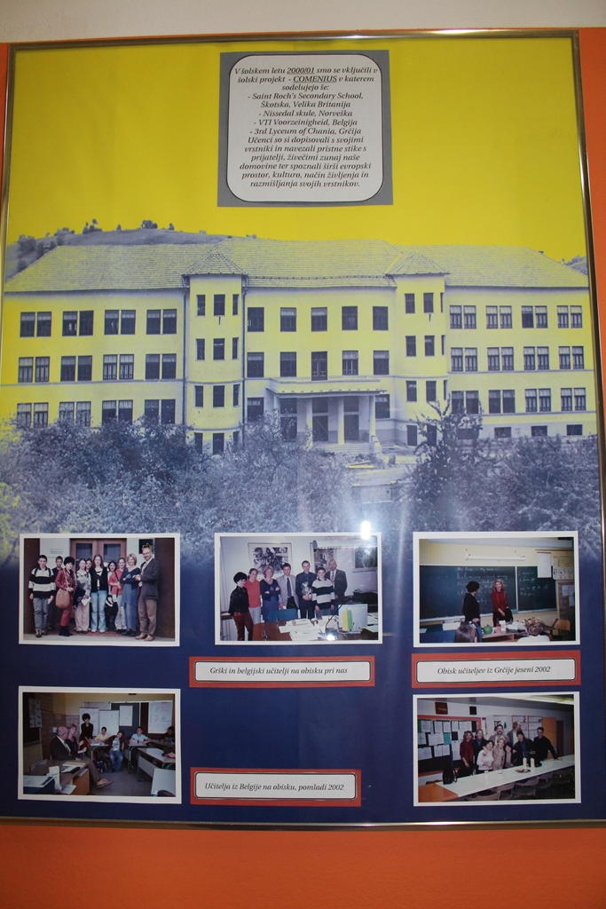
The project
This poster has pictures taken when
our school first participated in an
international project.

Slide 10
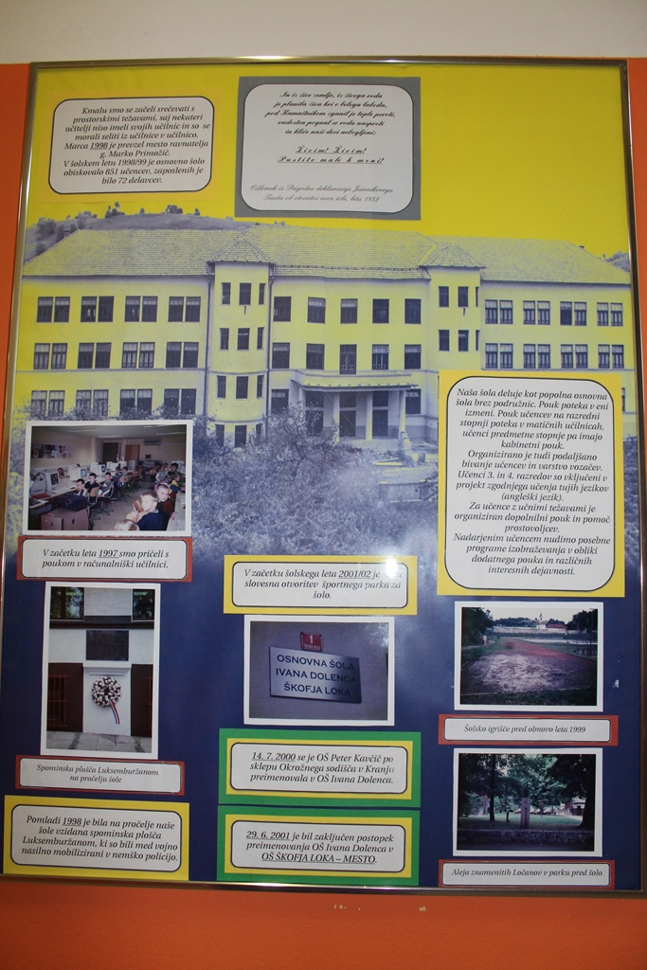
additions
The next poster shows the addition
Made to our school and its renaming to
Its current name OŠ Škofja Loka-Mesto.

Slide 11
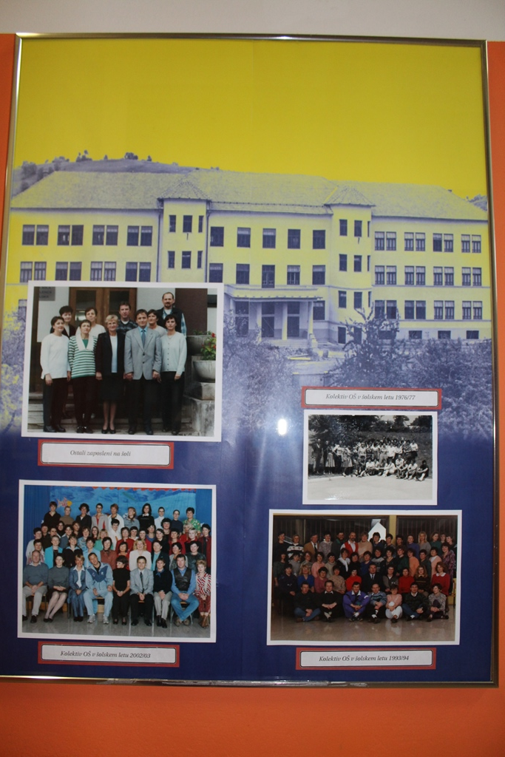
The people
This poster shows the pictures of
the employees through the years.

Slide 12
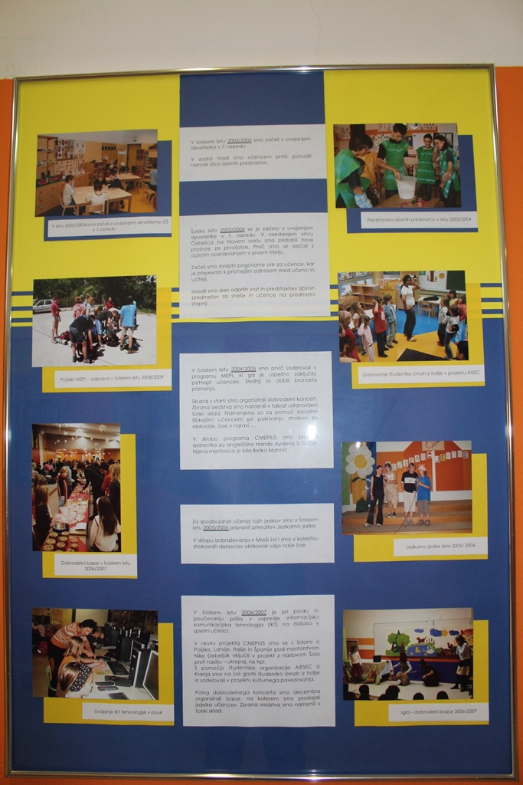
Special occasion
This one shows our school‘s students
on different special occasions and events.

Slide 13
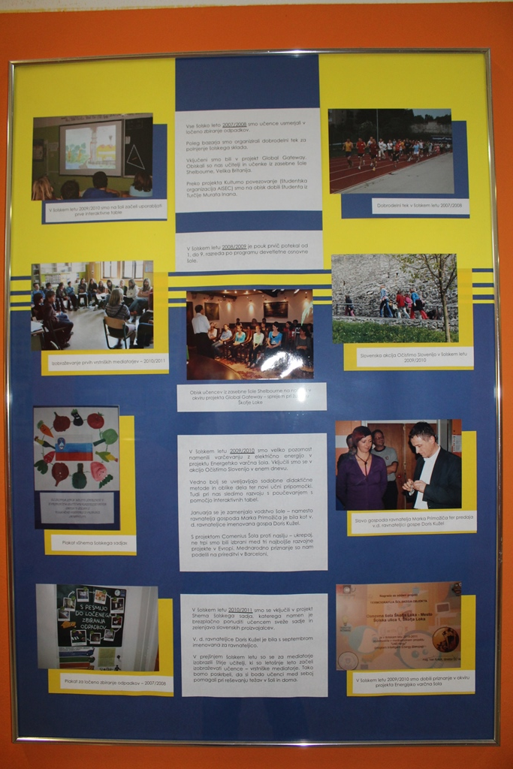
A new chapter
The last poster shows a few of the
excursions our students have gone to.
it also shows the passing of the torch
from our last principal to our current one:
Mrs. Doris Kužel.

