Slide 1
My beautiful country

Slide 2
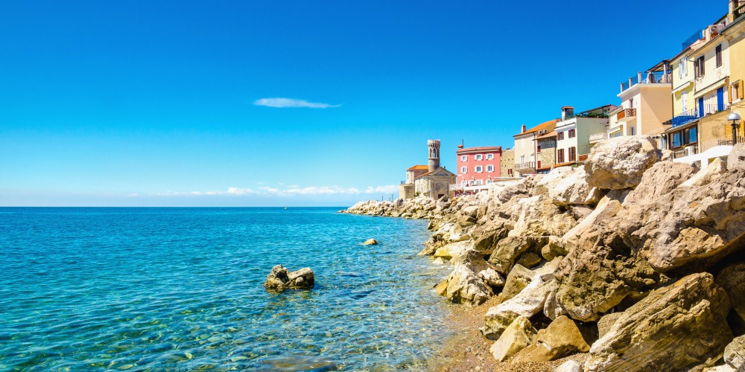
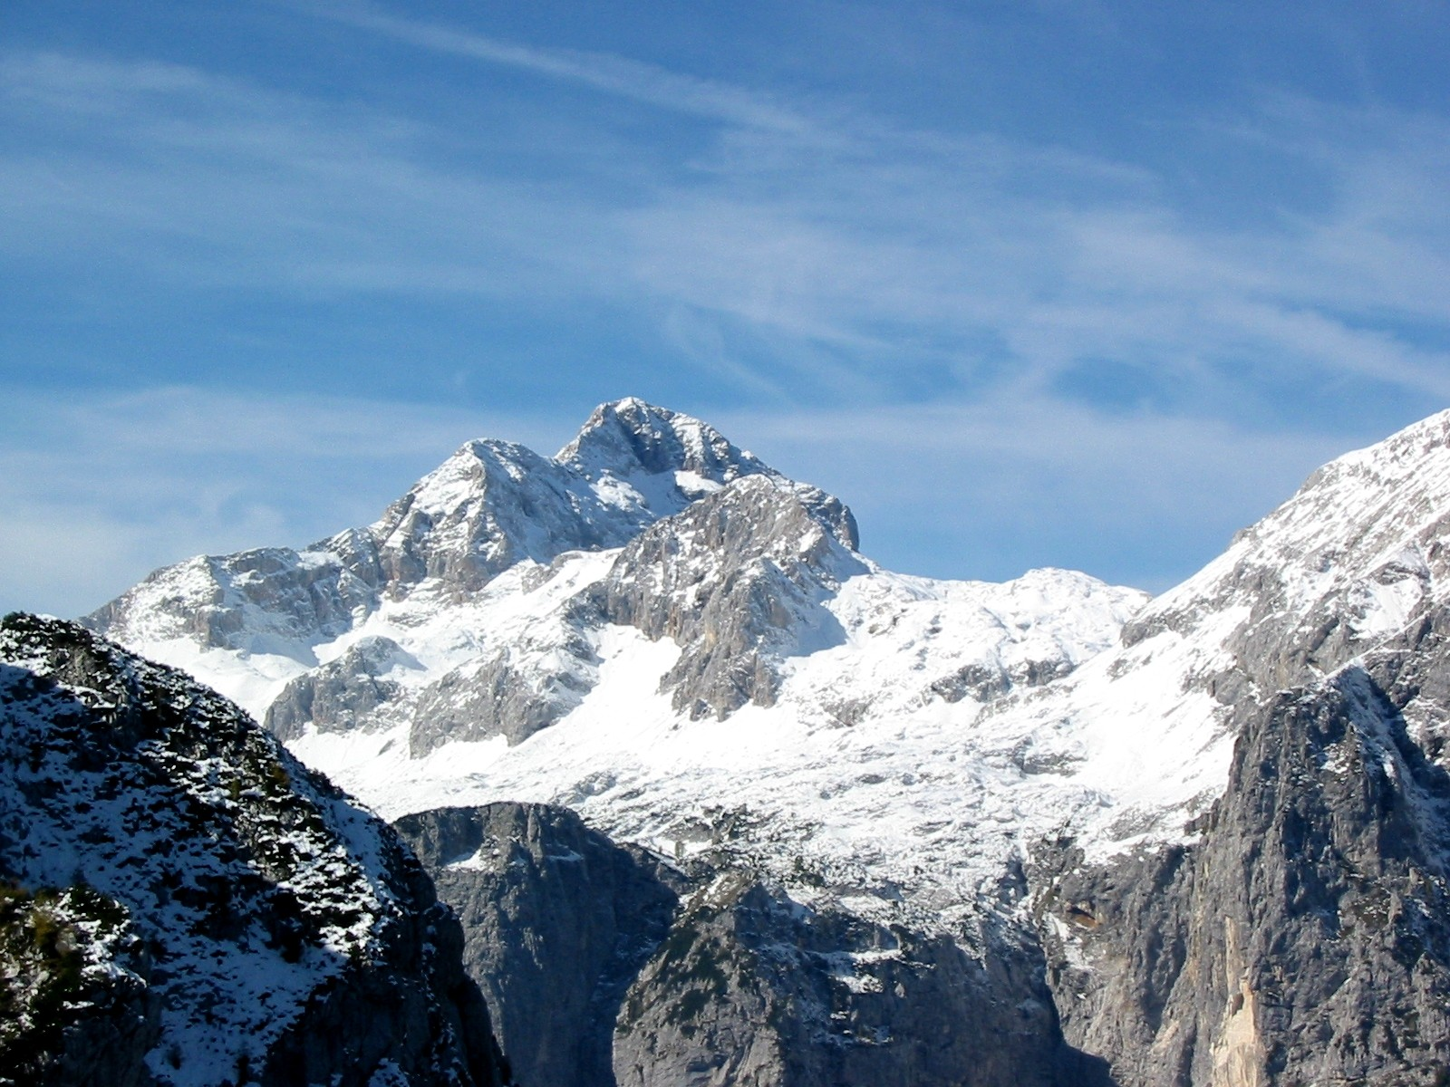
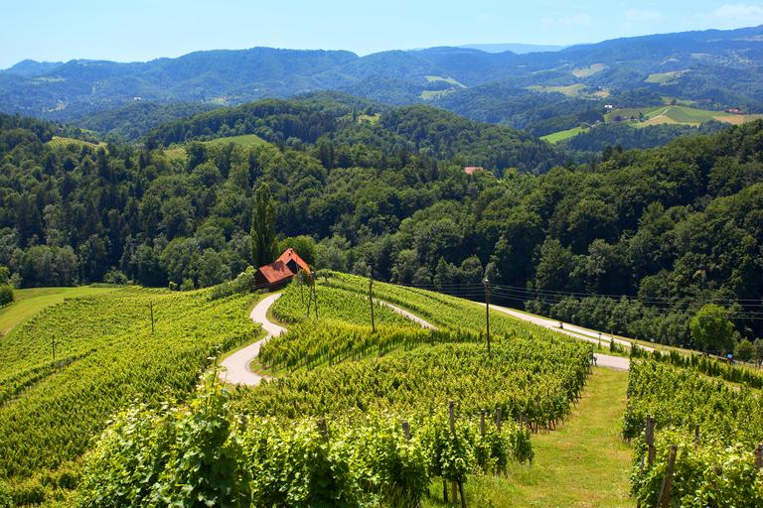
Slovenia is a very diverse country
In Slovenia you can find many different types of terrain like mountains, hills, plains the seaside…

Slide 3
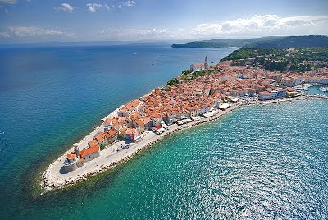
Our coastline
Slovenia has a coast that streches for 47 km. The biggest coastal city in Slovenia is Koper. The coast has the submediterranian climate.

Slide 4
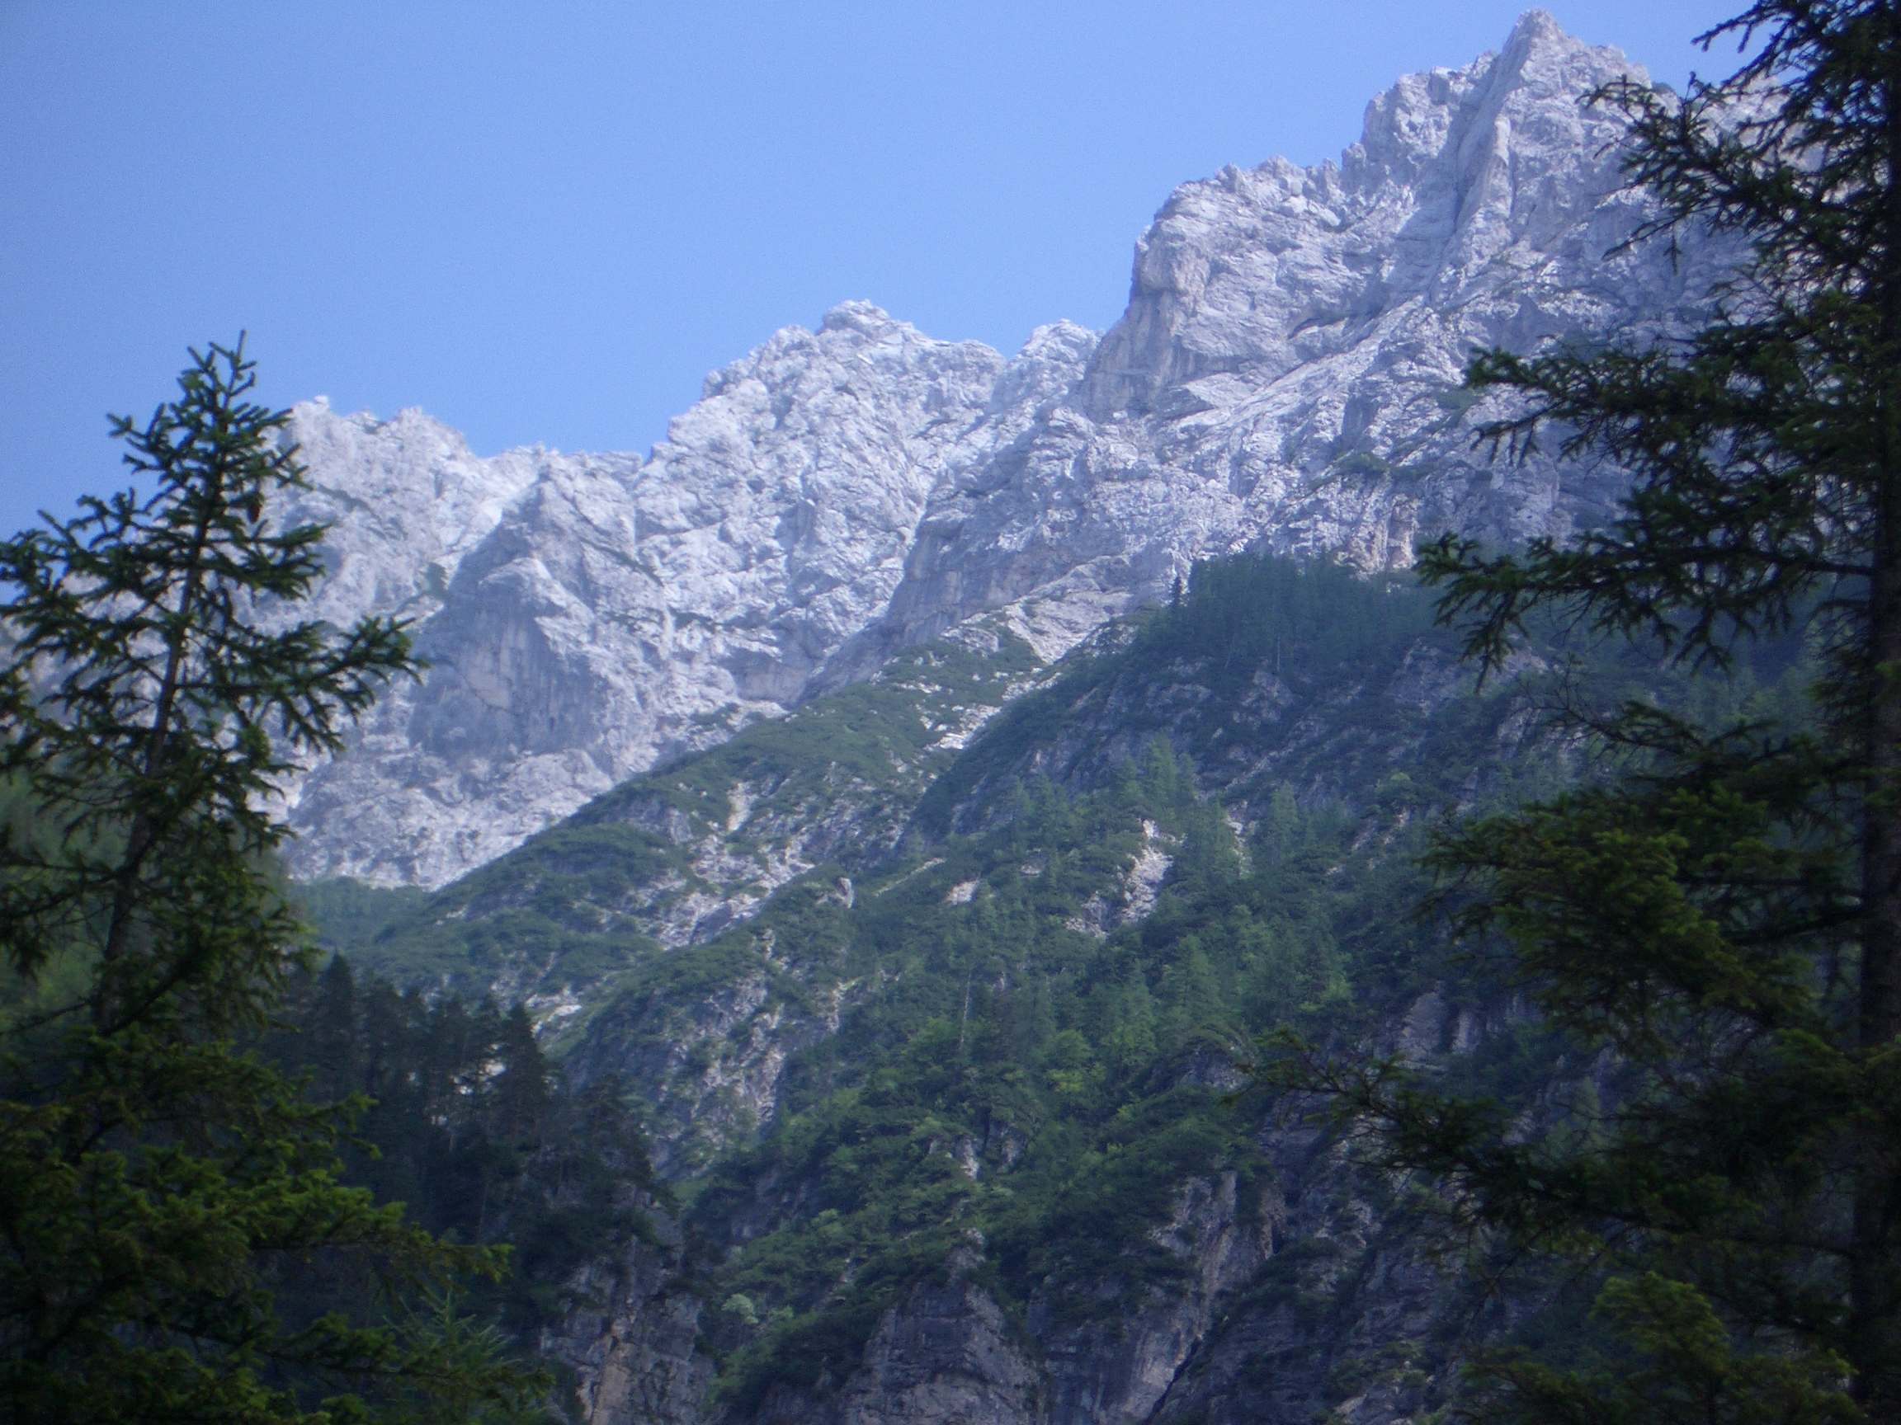
Our mountains
Most of our mountains are a part of the Alps. Our Alps are divided into three groups: the Julian Alps, Karavanke and Kamniško-Savinske Alps. The highest mountain in Slovenia is Triglav. It is one of the simbols on the Slovenian coat of arms. The Alps are a „young“ mountain range at areound 60 million years old. They are made of limestone.

Slide 5
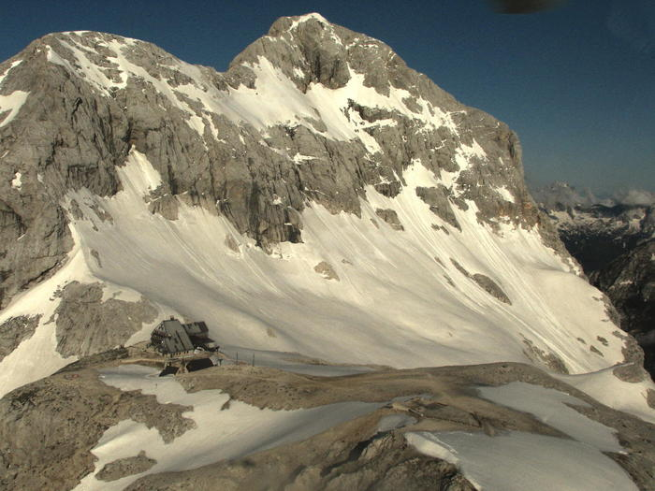
The Triglav „glacier“
We Slovenians like to brag that we have a glacier, even though most of the scientists of the world agree that it technicly speaking isn‘t a glacier because its core has broken apart to many pieces.

