Slide 1
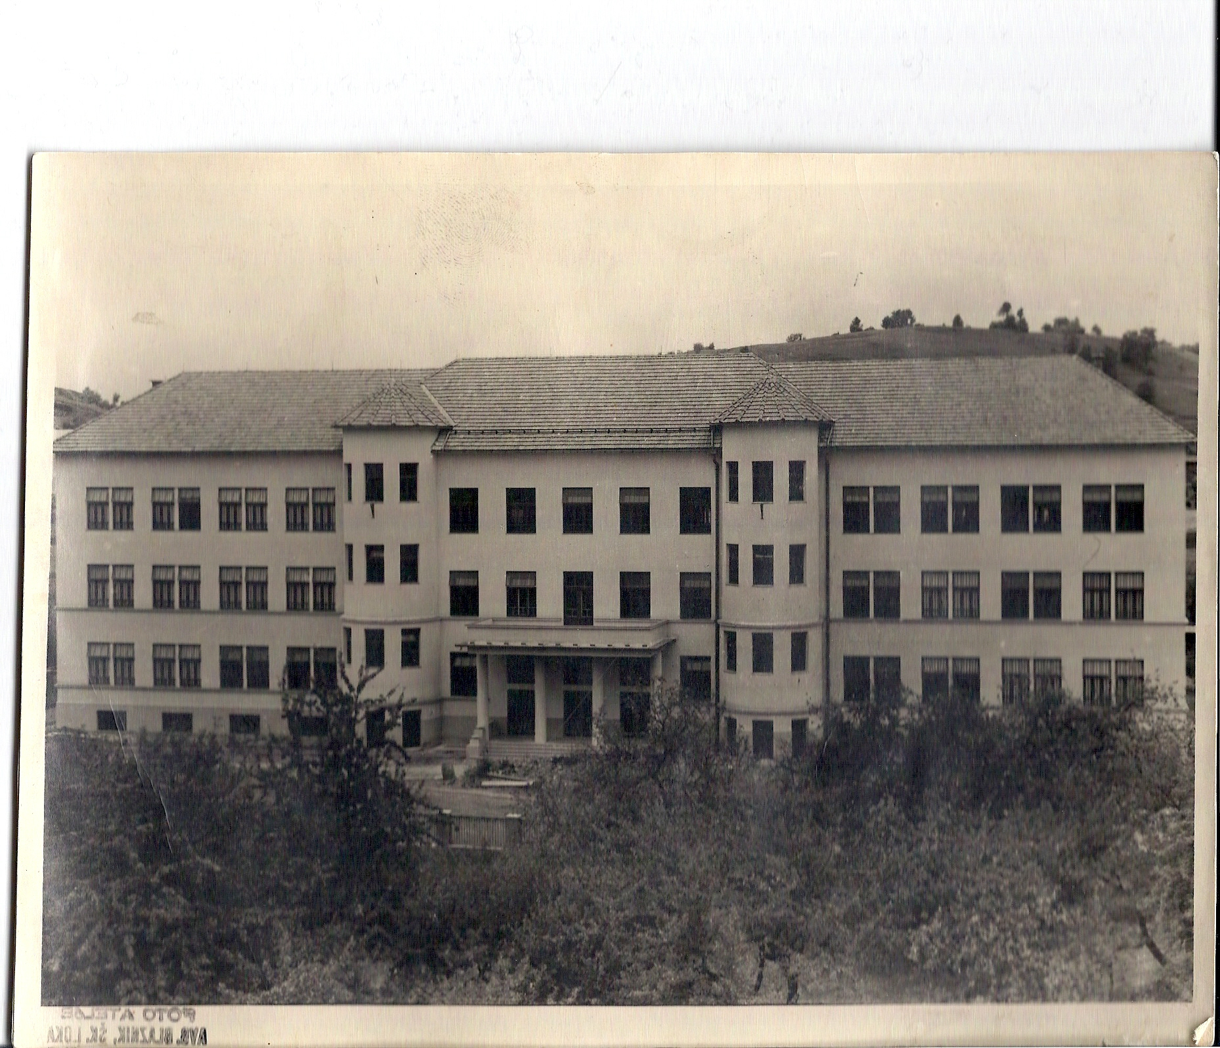
HISTORY OF OUR SCHOOL
Lidija Petrovčič with other teachers and pupils

Slide 2
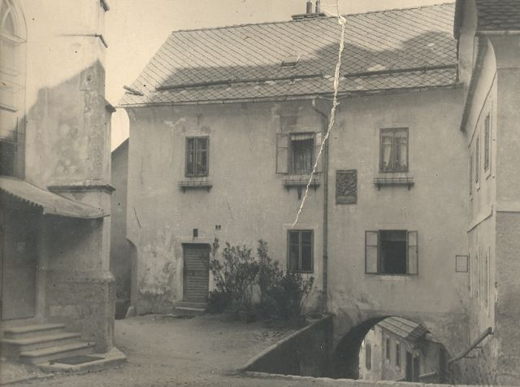
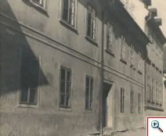
education in škofja loka
In the first half of the 19th century school for boys was in the town school at St. Jacob,and school for girls was at the Ursulinka sisters. In 1926, boys attended school at a house on Klobovsova Street.

Slide 3
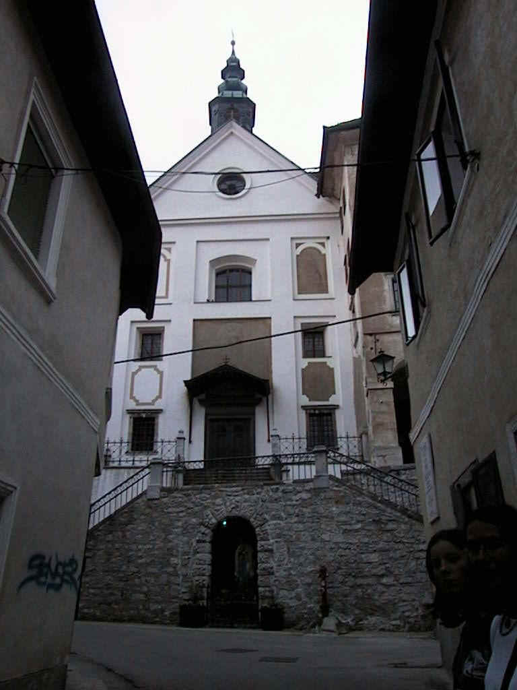
The girls’ school was a part of the Church of the Ursuline and the monastery below the Škofja Loka Castle. The Ursulinka sisters also had a special school for for the girls from remote villages.

Slide 4
As the old school became too small for all students, in 1927 they decided to build a new school building. The construction began in 1929 and ended in 1932.

Slide 5
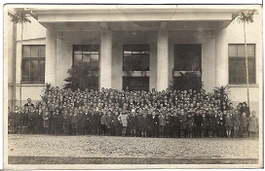
In September 1932, the students gathered in the old school and solemnly marched to a new school called the Škofja Loka-Town School. The building, with its two floors, was renowned for that time and was also called the School Palace. The formal opening and blessing of the school was held on November 29, 1932. The picture shows the students at the opening ceremony.

Slide 6
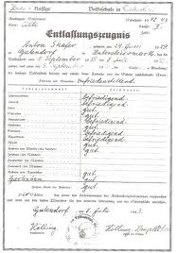
School between the world war ii
In May 1941, the school was taken over by the German Commission - the German Political Commission, German teachers came in July.The visit was bad - the students were punished if they spoke Slovenian. In May 1944, the wounded were resettled at the school and classes were interrupted.
THE REPORT

Slide 7
SCHOOL in SFRJ
After the liberation, the partisan squads occupied the school and began renovating the building. On June 11, 1945, 502 students began their classes, 4th grade - then compulsory at lower gymnasium, 1951/52 - apprenticeship school, In October 1953, the grammar school tract was completed. The elementary school only had 7 classrooms for 14 classes - shift lessons, in 1958 - the lower gymnasium was abolished - 35 departments of elementary schools. School day was celebrated on March 18th, 1960, In March 1966, it was renamed to the Škofja Loka Elementary School, Peter Kavčič,

Slide 8
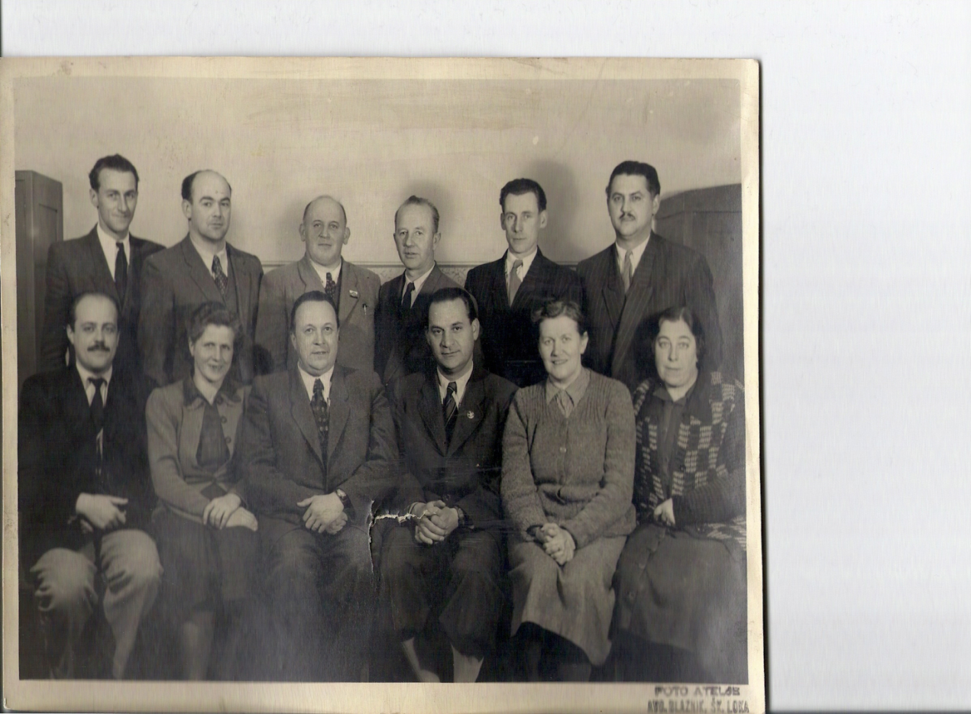
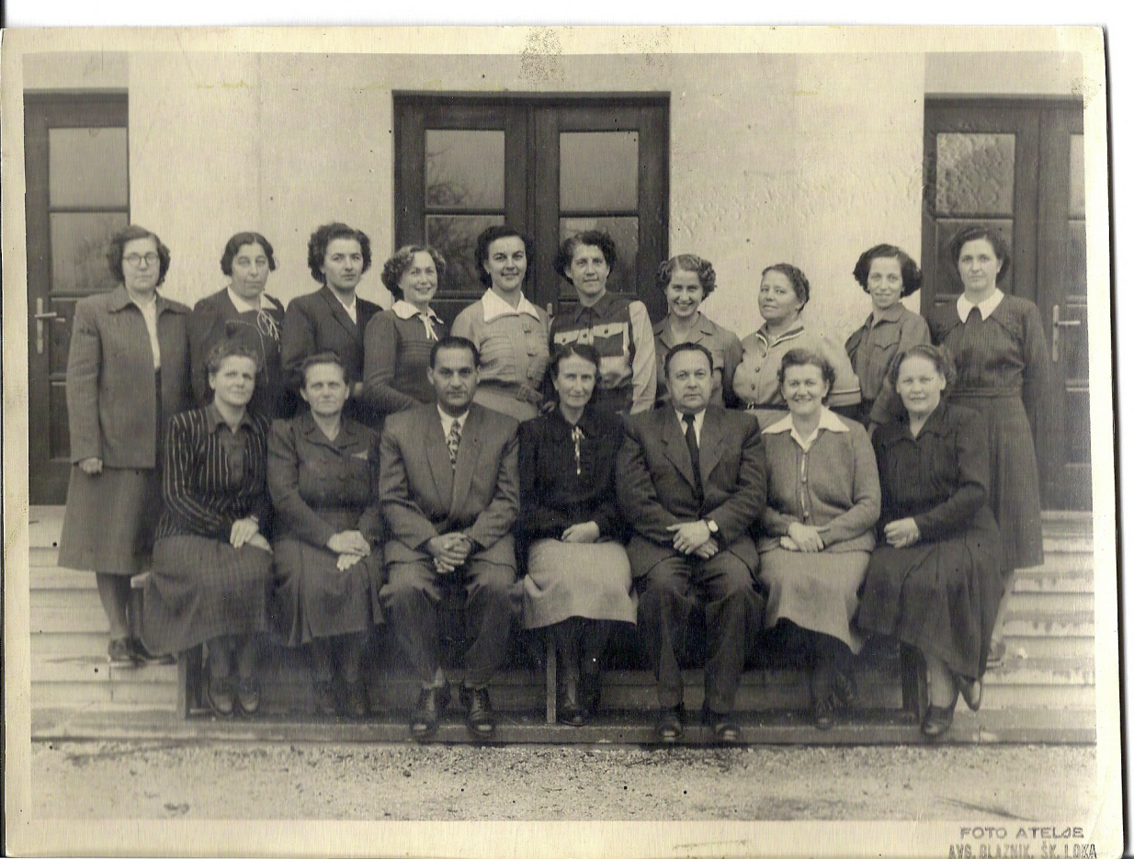
TEACHERS IN 1952
TEACHERS 1955

Slide 9
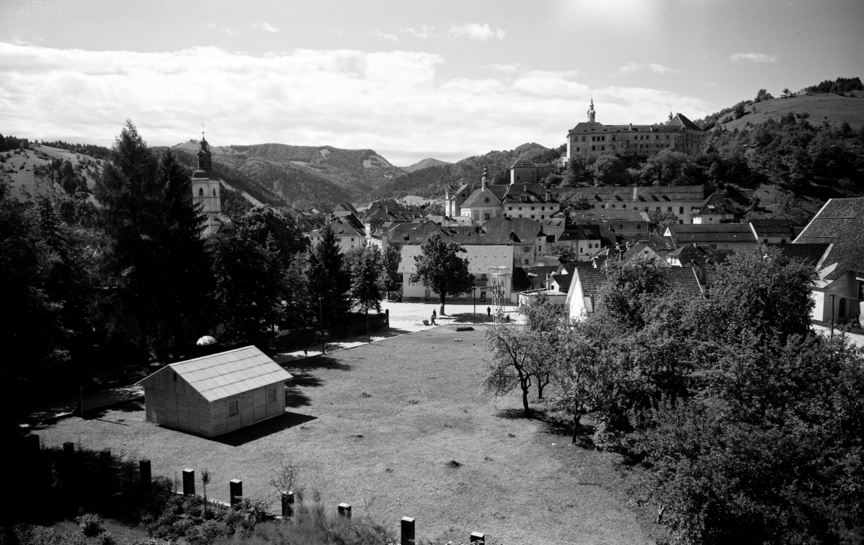
View of the Old Post Office, School Garden and the School Street in 1975

Slide 10
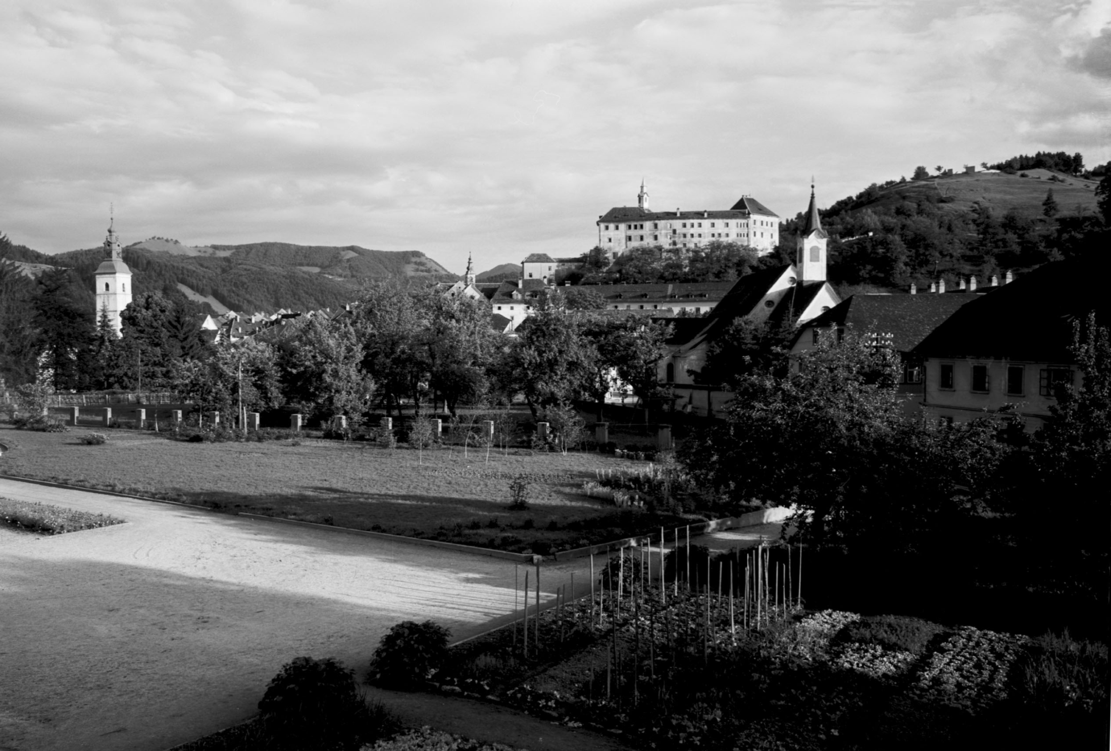
In 1958/59, a park was arranged in front of the school and there was a school playground for the schoolchildren.

Slide 11
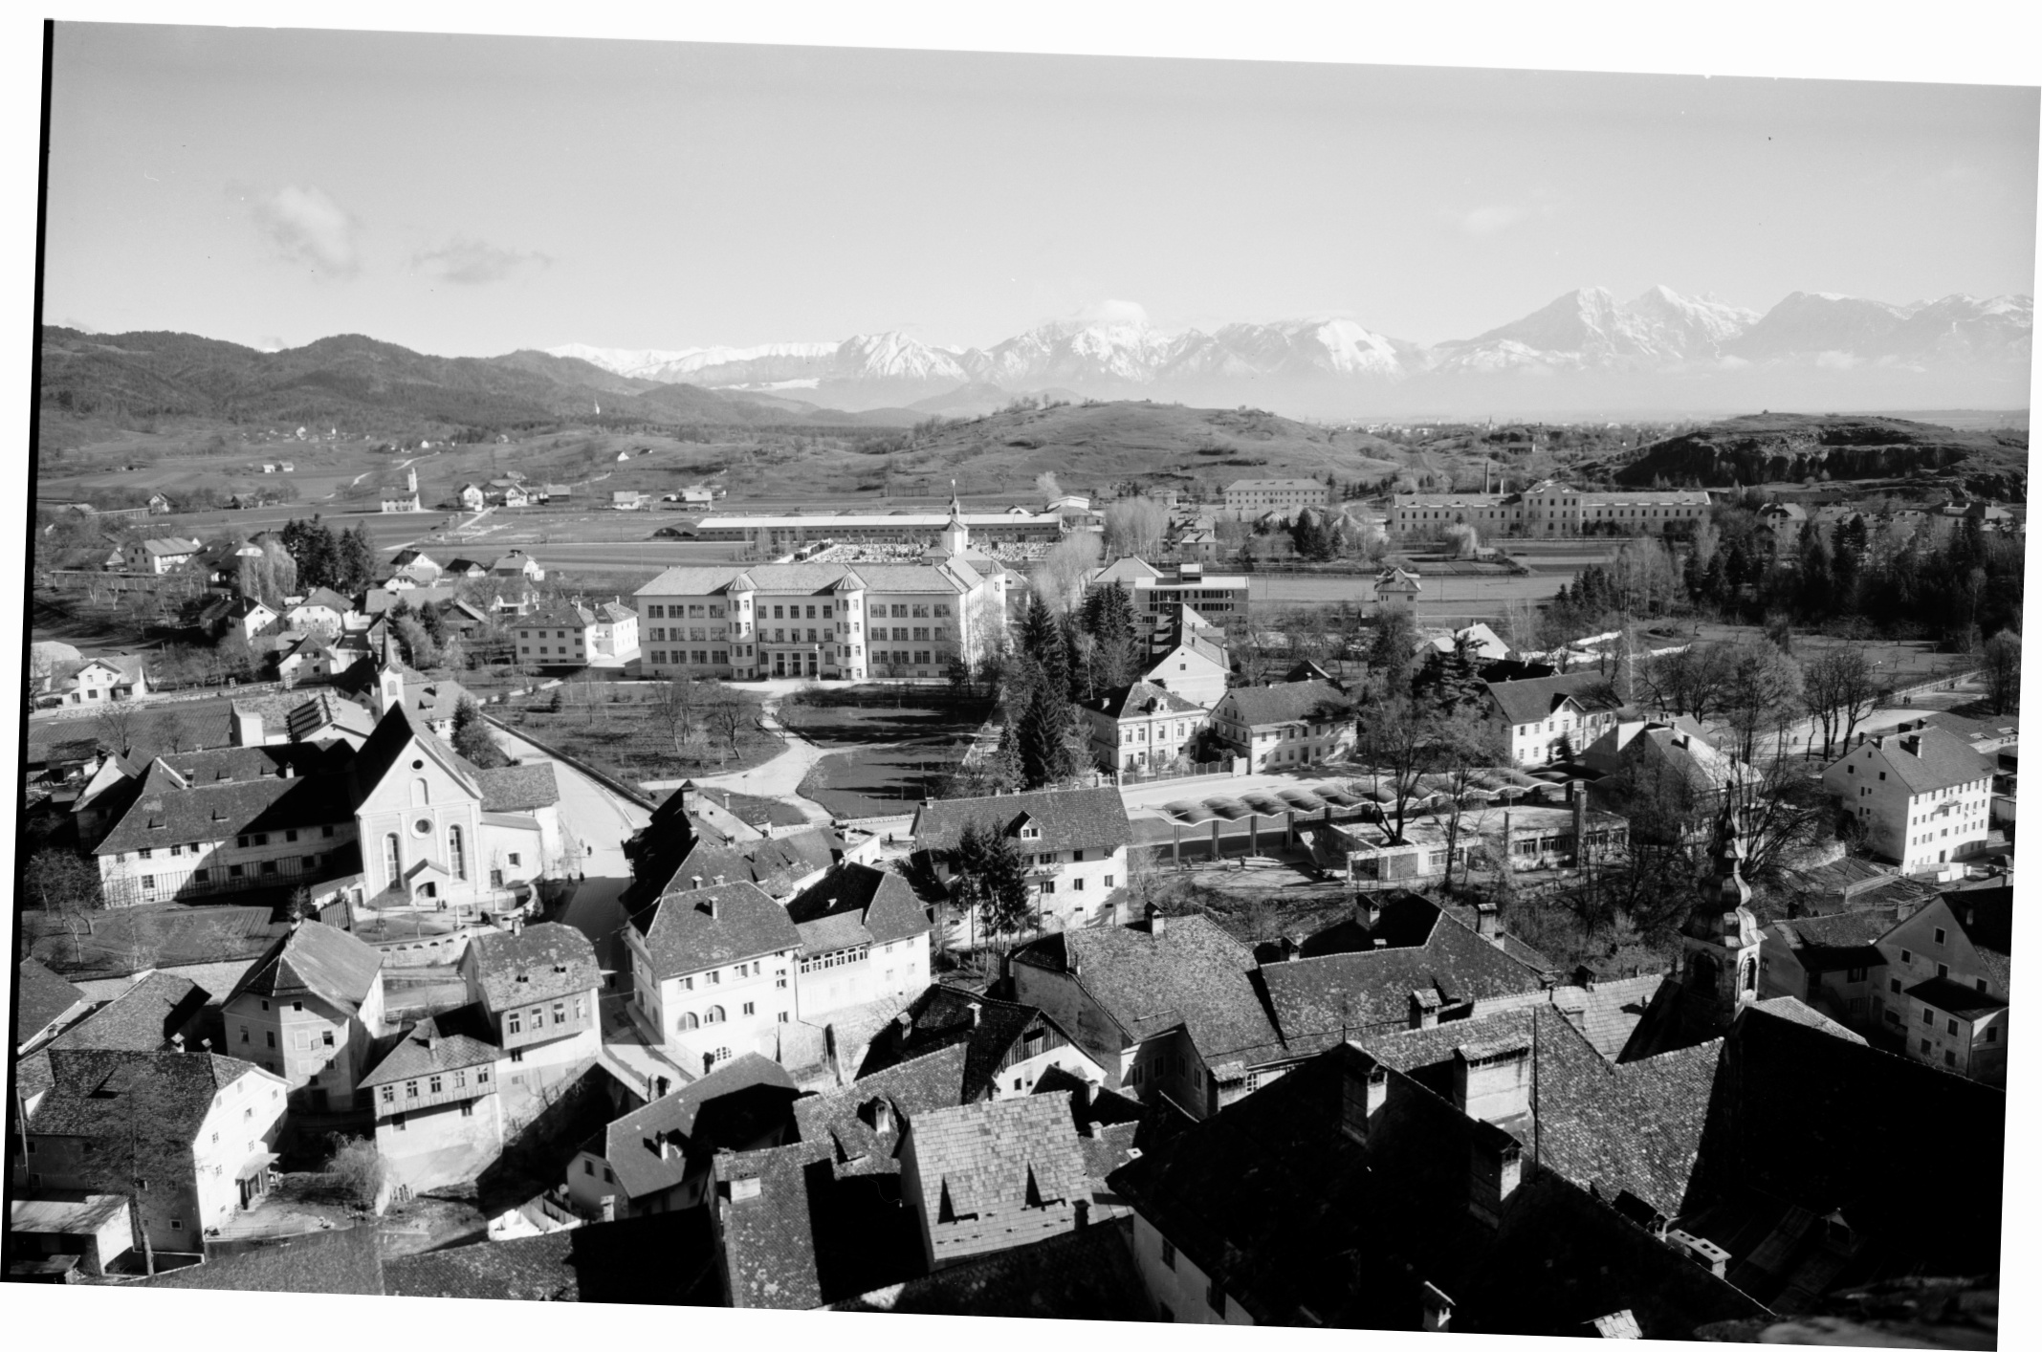
The view on our school in 1960.

Slide 12
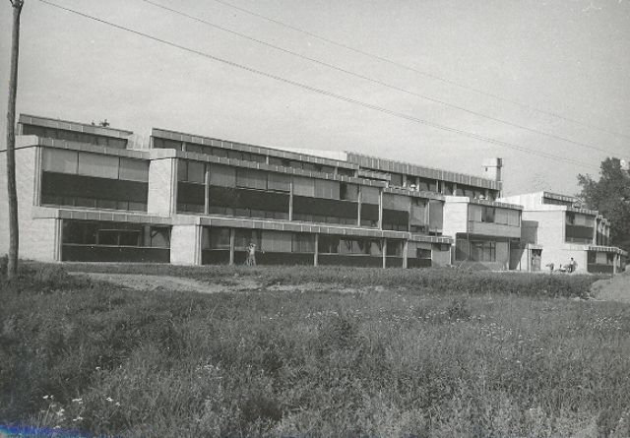
The number of pupils was constantly growing and a new school building was built in Podlubnik in 1973. Graduate students remained in the old school and the subject class moved to the new school

Slide 13
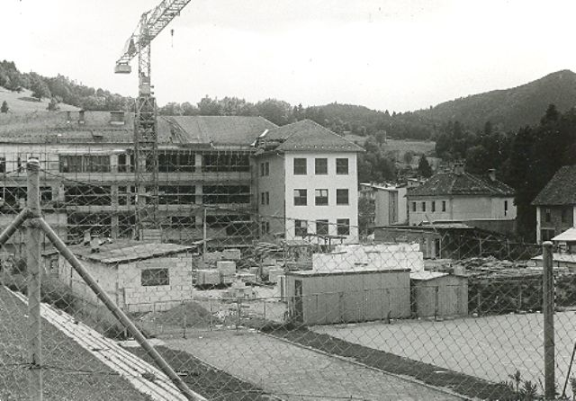
After the apprenticeship school and high school had been evicted, the reconstruction of the school began. It completed in 1985 – This was an eight-year school - Peter Kavcic Primary School.
In Podlubnik, the school is named after Ivan Grohar Elementary School.
In 1985/86, 996 pupils in 33 classes attended the school.
Renovation of the school in 1983

Slide 14
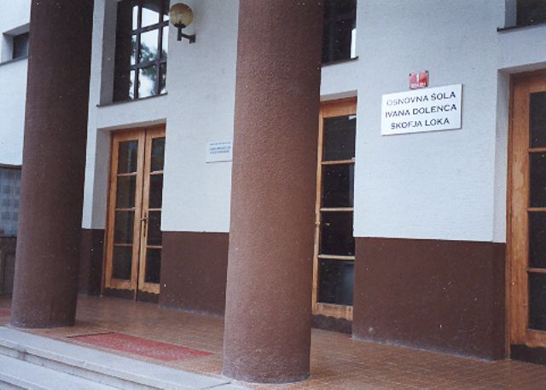
Independent Slovenia
After the renovation, the school became a modern school with modern classrooms.
The school was renamed to the Ivan Dolenec Elementary School in July 2000, but it only lasted until 2001.
Since June 2001 it has been called the Škofja Loka- Mesto Elementary School -
A board with the name of Ivan Dolenc Primary School
(vir:Foto arhiv OŠ Škofja Loka – Mesto)

Slide 15
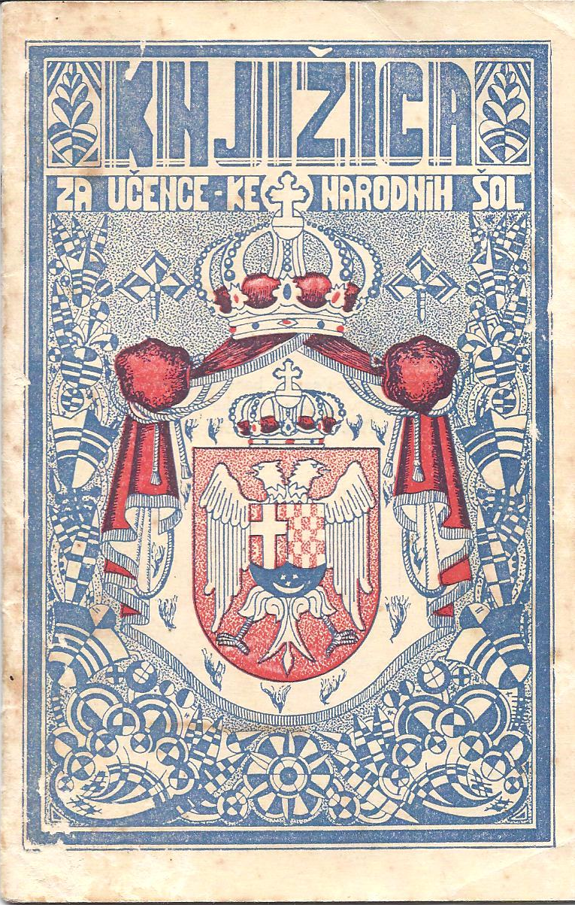
Briefly about life and ways of teaching in school at different times
In 1932, when the history of our school building begins, we fell into the Kingdom of Yugoslavia, which was then run by King Alexander until 1933, and then on behalf of his youngest son Peter - Regent Pavle of the Karadjordjevic Dynasty.
The students learned Slovenian, computer science, writing, handwriting, hand-drawing, drawing, singing, gymnastics, religious instruction.
Cover of the 1933 certificate

Slide 16
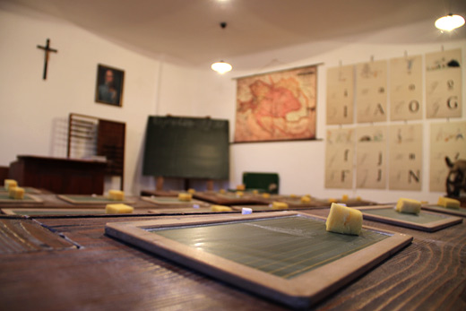
An example of a classroom from the Kingdom of Yugoslavia with a portrait of a king on the wall

Slide 17
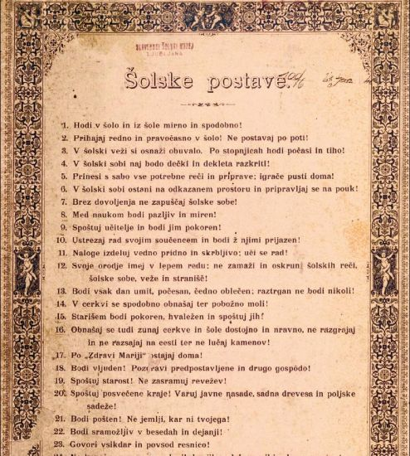
School rules from the time of the Kingdom of Yugoslavia

Slide 18
After World War II we lived in the Socialist Federal Republic of Yugoslavia headed by President Tito until his death in 1980.
In schools, students were taught similar subjects as we know them today, with only slightly different content - history - battles in the National Liberation War across Yugoslavia, and they also had a Serbo-Croatian language in Cyrillic.
Example of SFRJ school certificate

Slide 19
The school was up to 70 years 6 days a week.
They went to school at the age of 7 and attended it for 8 years.
In 1st grade, they were cicibians, and at the end of the year they were accepted by a ceremonial event at the Pioneer Organization, which was operating since 1942.
They took a pioneering oath.
Honorary Pioneer - Solemn Pioneer Vow Before the pioneer flag, I promise to study diligently and persistently. With my knowledge and dedication, I want to benefit our socialist homeland of Yugoslavia and all its working people now and when I grow up. I promise to be a loyal companion and a good man. Let all my work and conduct show that I am a worthy child of my people and a worthy member of a large family of nations who want the path of progress, justice and peace.

Slide 20
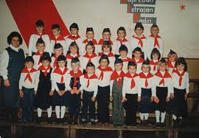
To give honorable pioneering is not a cat's cough, as he is a pioneer:
P = honest
I = honest
O = painted
N = fearless
I = resourceful
R = generous
they were pioneers until 7th grade when they were accepted among the juniors on May 25 (Youth Day)
The pioneers were dressed in white shirts, blouses, blue skirts or pants. They were given a special hat (a partisan cover during World War II named after Marshal Tito) and red scarves.

Slide 21
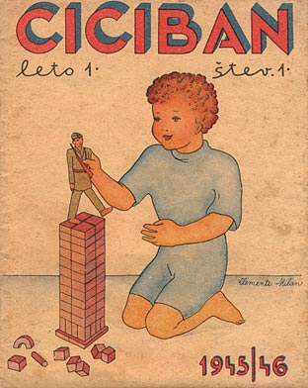
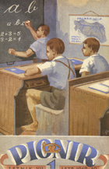
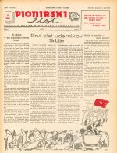
They also knew magazines:
Ciciban and Pionir were first published in 1945
The Pioneer paper was first published in 1948 - today it is called PIL.

