Slide 1
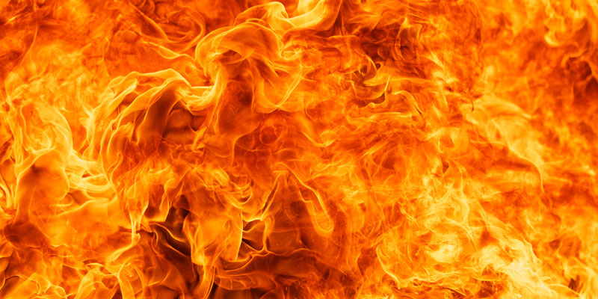

Between two fires

Slide 2
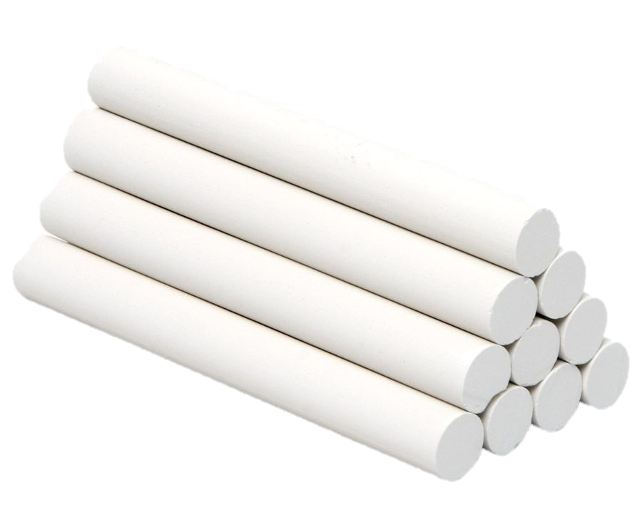

We need:
A chalk
A ball

Slide 3

How to play?:
First we have to make two matching groups. Then we need to select a leader (we call the leader odposlanec).

Slide 4
How to play?:
Every group can have one half of rhe space. With chalk we need to draw lines. If a leader is in the left corner, your team is in the right half-or opposite.
TEAM 1
TEAM 2
LEADER OF TEAM 2
LEADER OF TEAM 1

Slide 5
How to play?:
Every student has one life (you lose your life if you are hit by ball), but a leader has three lifes. The leader enters the game when there are just two students of his team playing. If you are shoot, you go to a leader and help him.

Slide 6

How to play?:
If the ball bounces from the floor to you or you catch the ball, you don‘t lose your life.

Slide 7

The goal is:
One team wins when every students from other team are shoot.

Slide 8
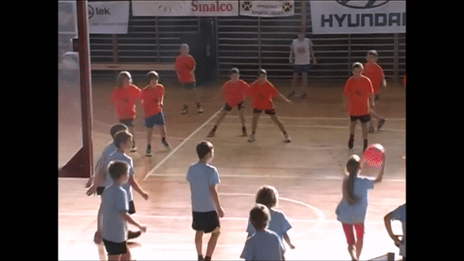

Slide 9
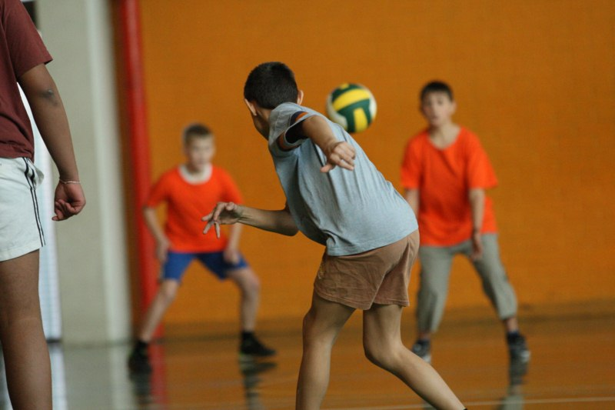
The end
Thank you for your attention! I hope that you will enjoy the game.

